Slide 1

Unicorn Growth
Athena Wu
Ian Nguyen
Lana Huyen
Oty Baasandorj

Slide 2

Overview:
A PRIVATELY HELD STARTUP WITH VALUATION ABOVE 1 BILLION USD
Using the data of each unicorn company between 2022 and 2024, we will look at:
The relationship between growth and: Industry, year inducted as a Unicorn company, and location
Visualizations of the data
Analysis

Slide 3
INDUDSTRY 2022 GROWTH
Artificial Intelligence experienced the highest average growth rate, while the E-commerce & Direct-to-Consumer and Edtech industries saw significant declines.

Slide 4
INDUDSTRY 2023 GROWTH
Data Management & Analytics and Artificial Intelligence industries had notable growth, whereas the Internet and Supply Chain, Logistics, & Delivery industries experienced a decrease

Slide 5
INDUDSTRY TOTAL GROWTH
Artificial Intelligence and Other industries demonstrated the most substantial average total growth, highlighting their strong performance over the period, while the E-commerce & Direct-to-Consumer and Edtech industries underperformed

Slide 6
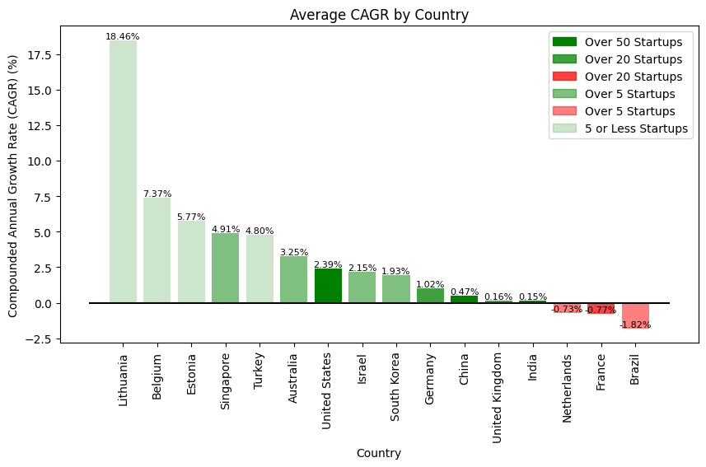

Slide 7
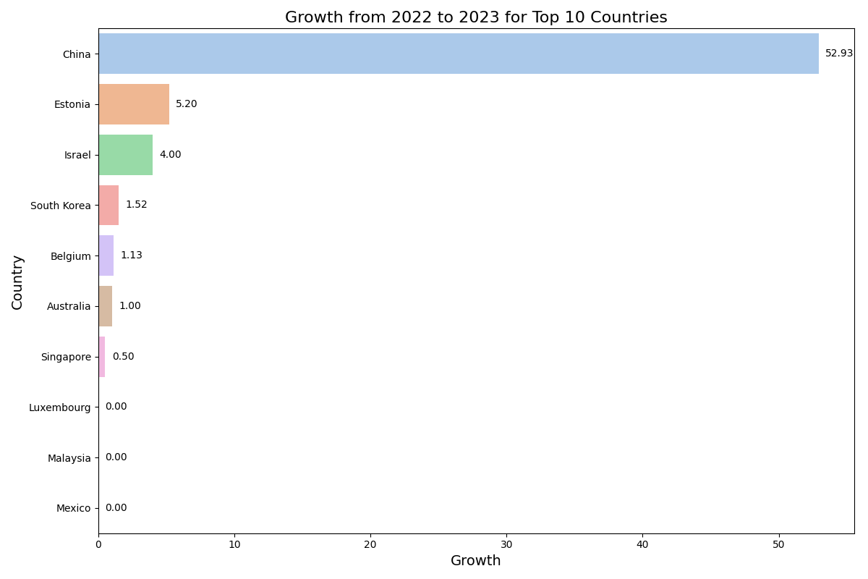
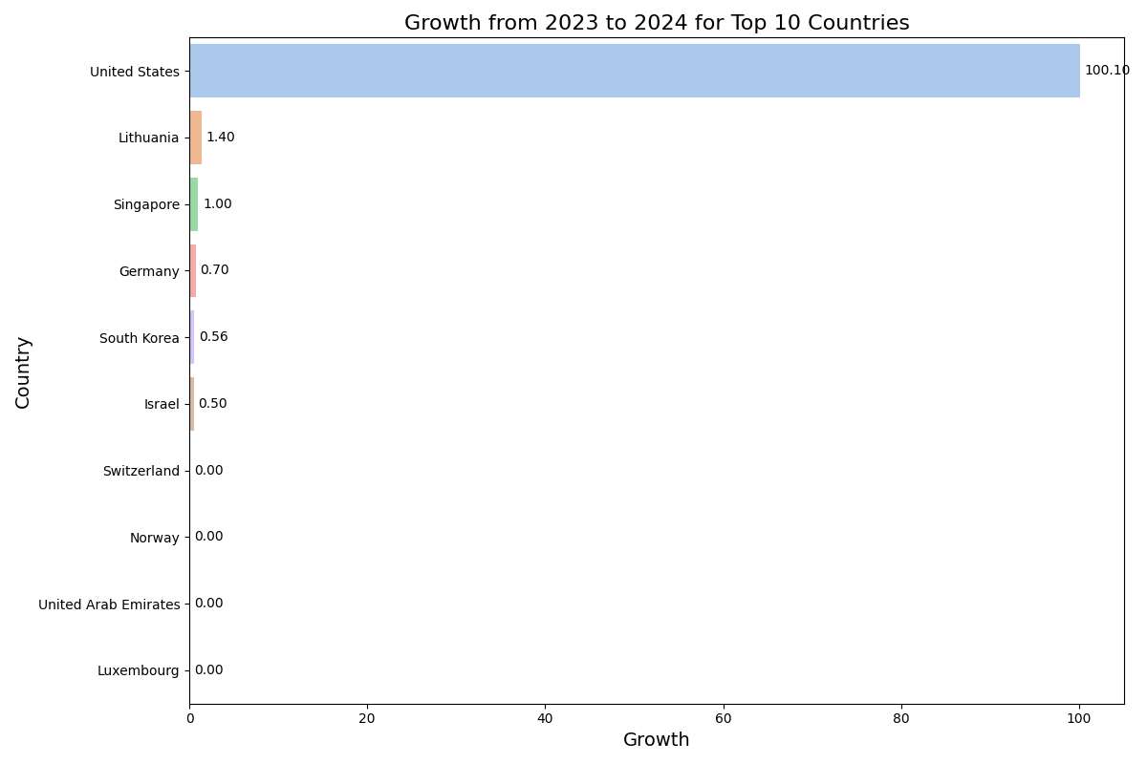
China had the highest growth from 2022 to 2023 with a growth of $52.93 Billion across all industries.
Whereas from 2023 to 2024, the United States experienced a growth of $100.10 Billion.

Slide 8
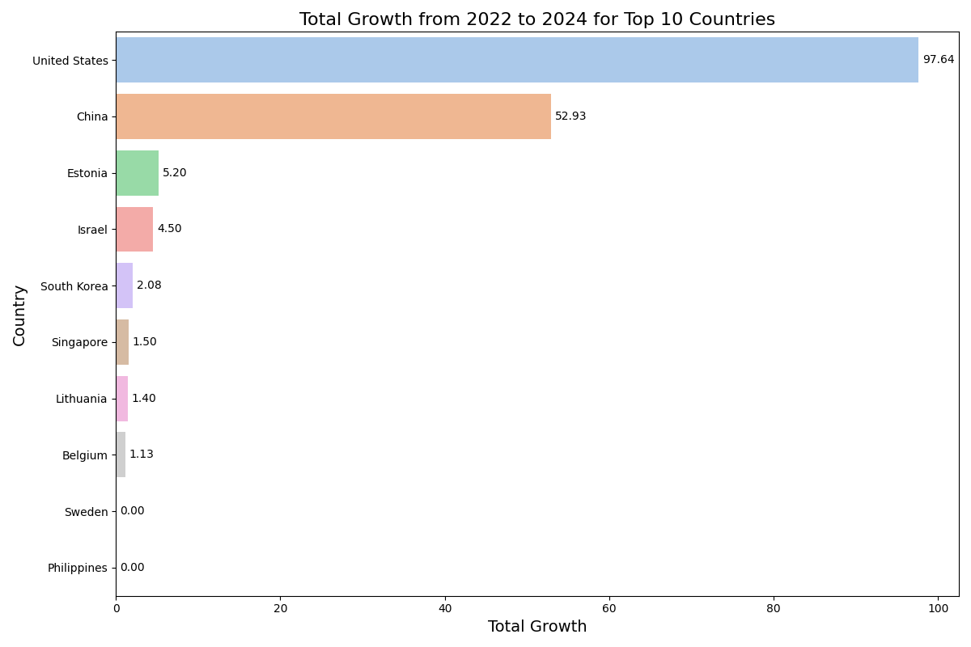

Slide 9
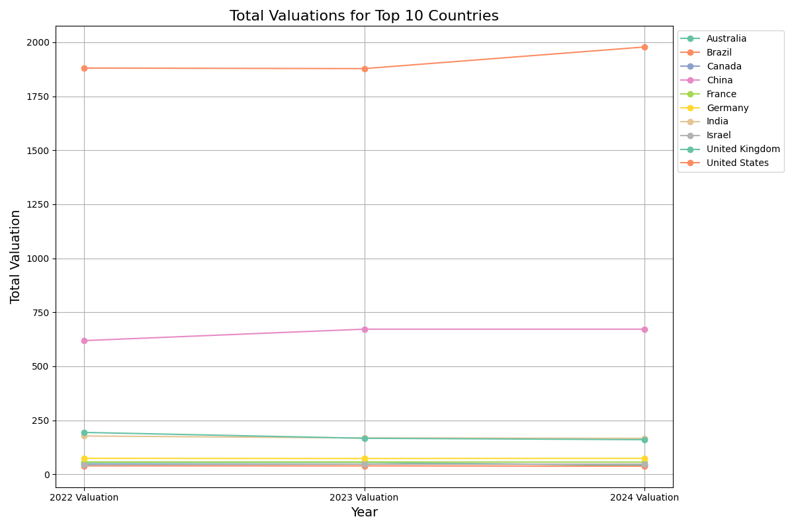
The United States and China are leading the world in their total valuation of all companies in their countries.

Slide 10
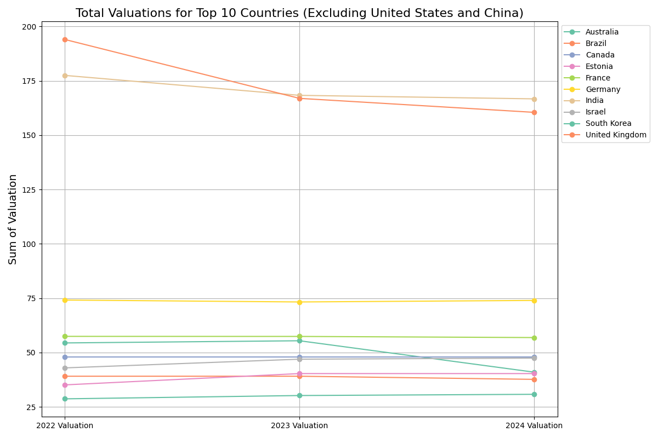

Slide 11
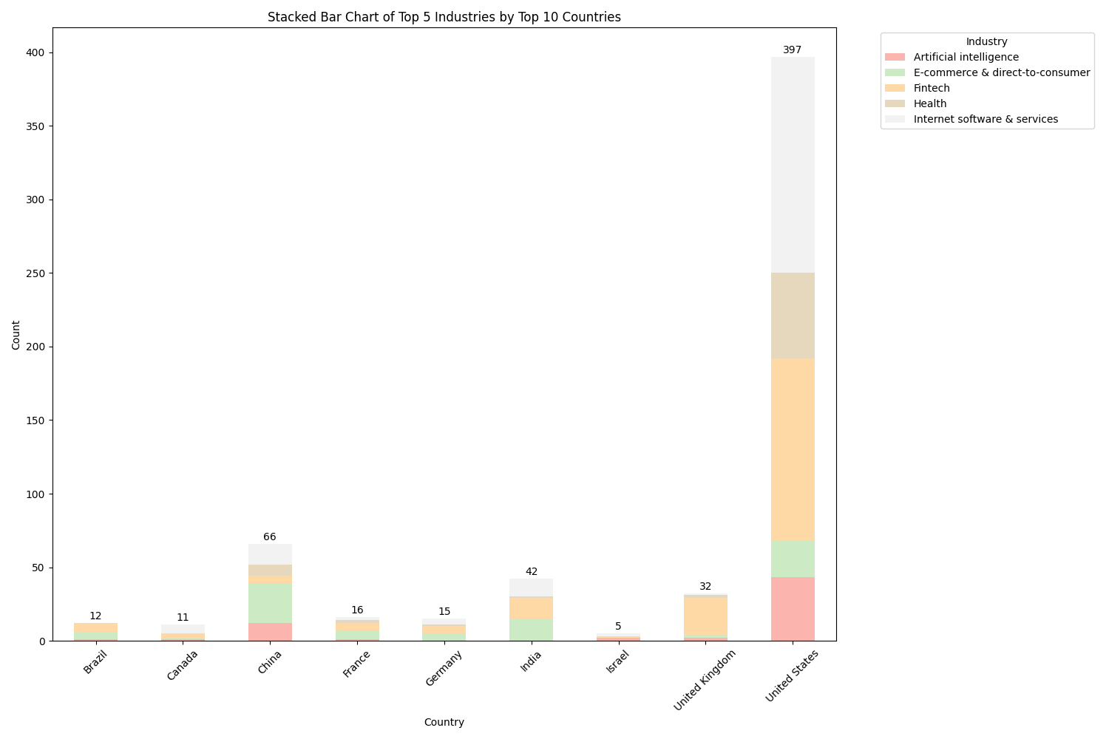
The United States is also leading in the number of unicorn companies at 397 as China is next with 66 companies.

Slide 12
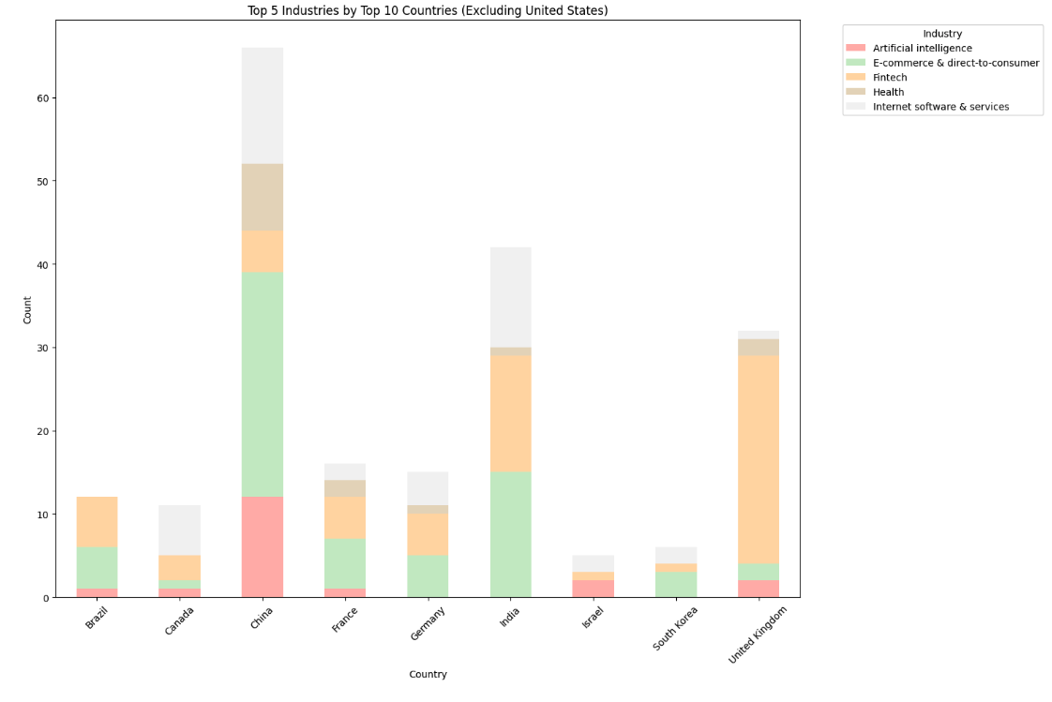

Slide 13
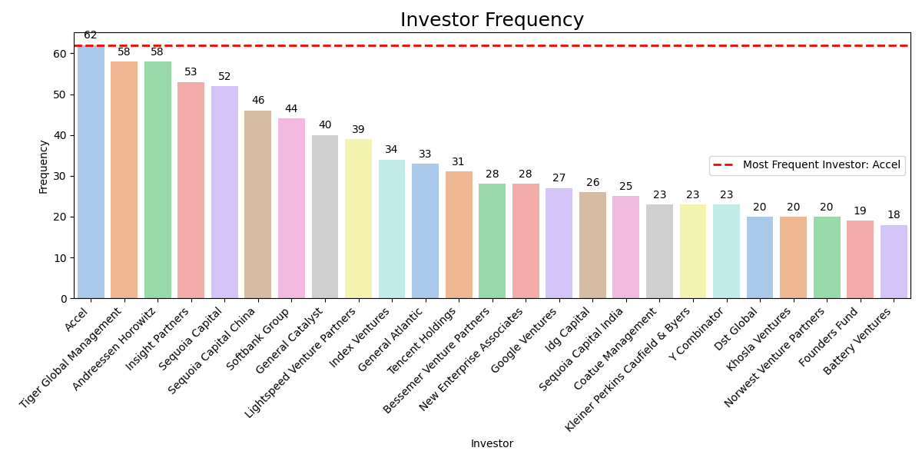
From a total of 1189 select investors, Accel has invested the most, in 62 companies. Accel has invested mainly in internet software & services. Other industries include cybersecurity, artificial intelligence, health, hardware, and more.

Slide 14
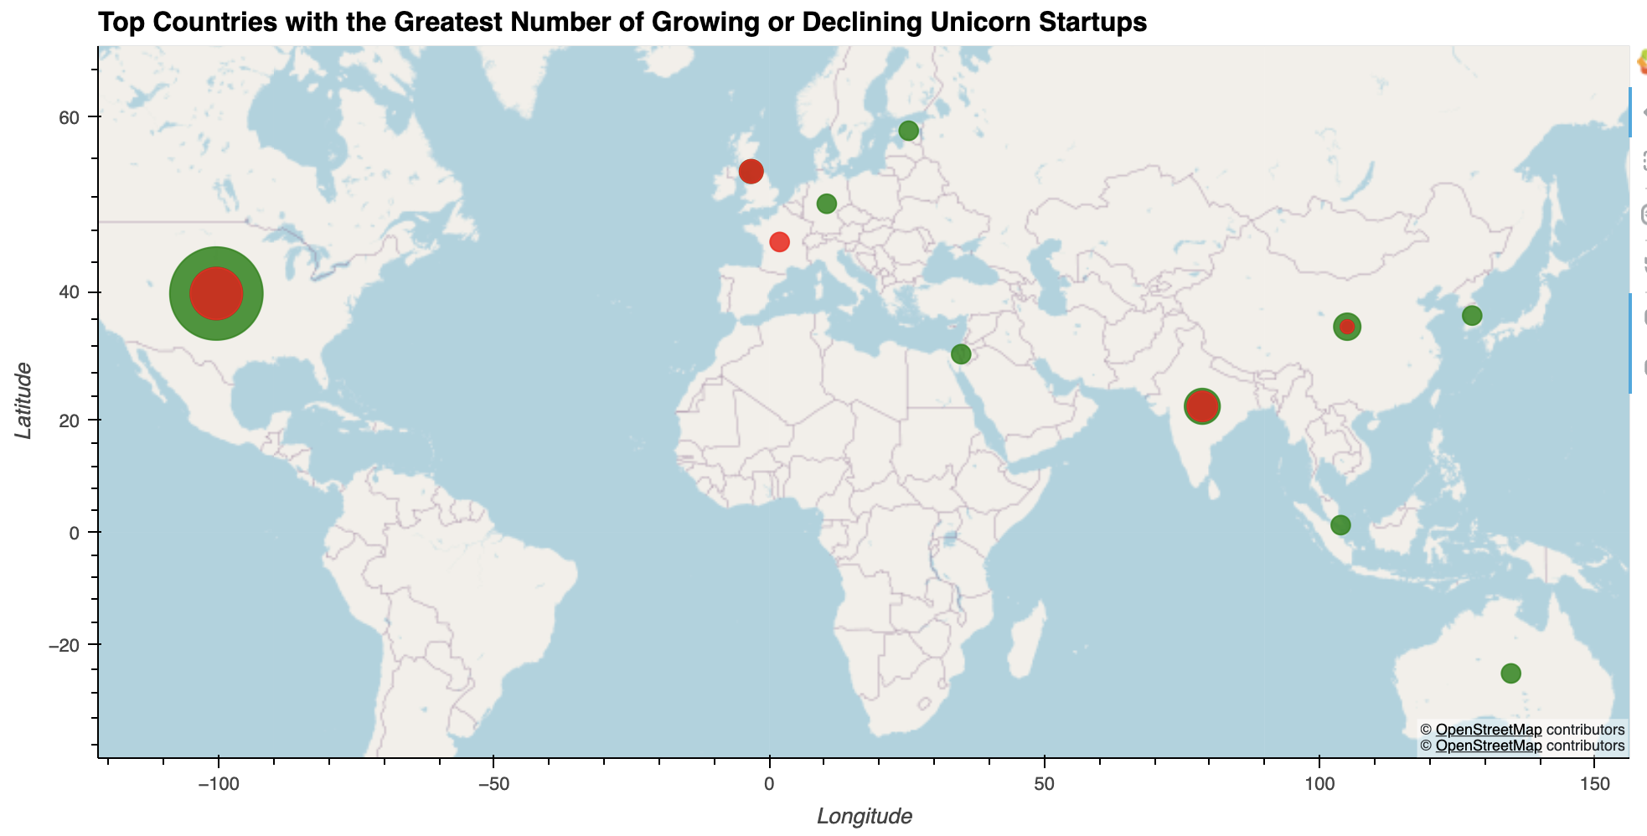
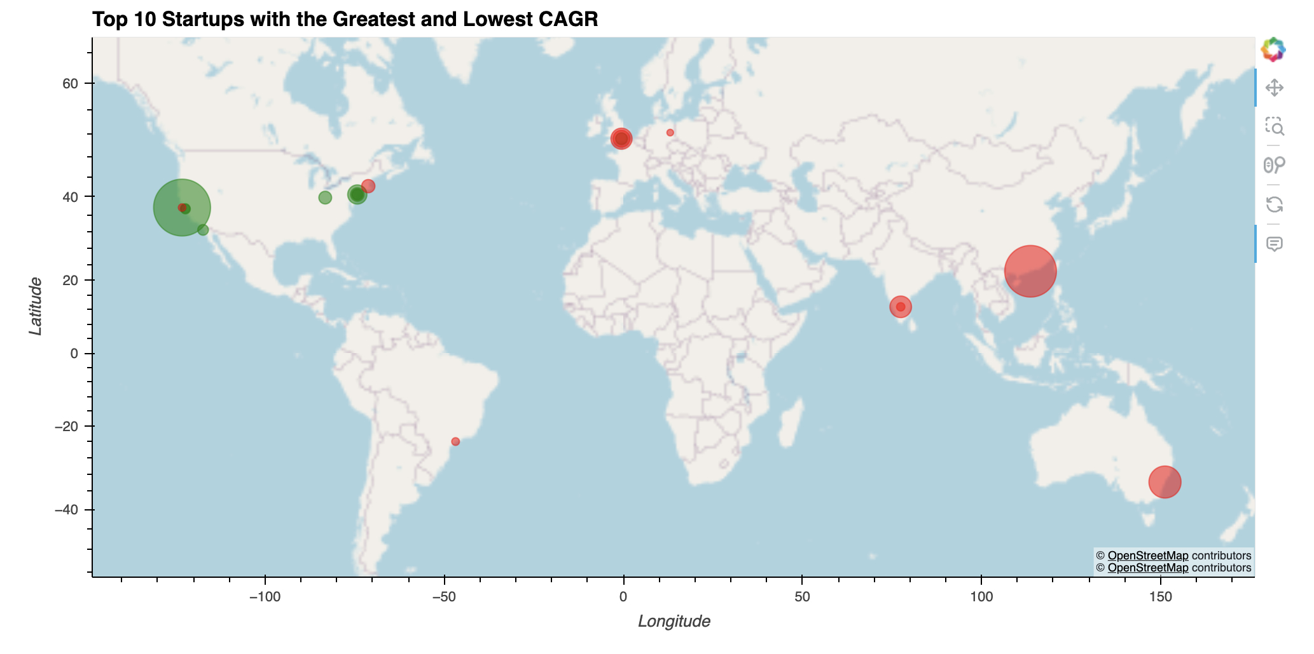
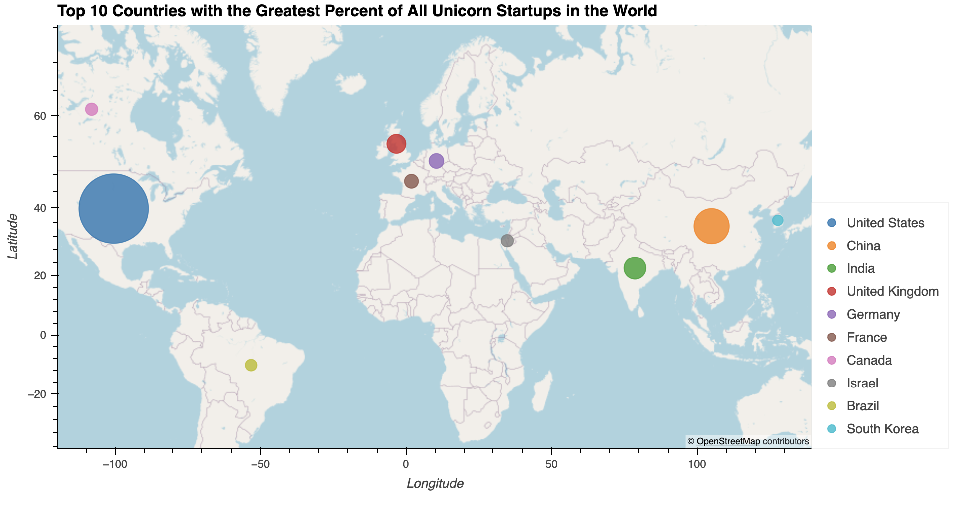
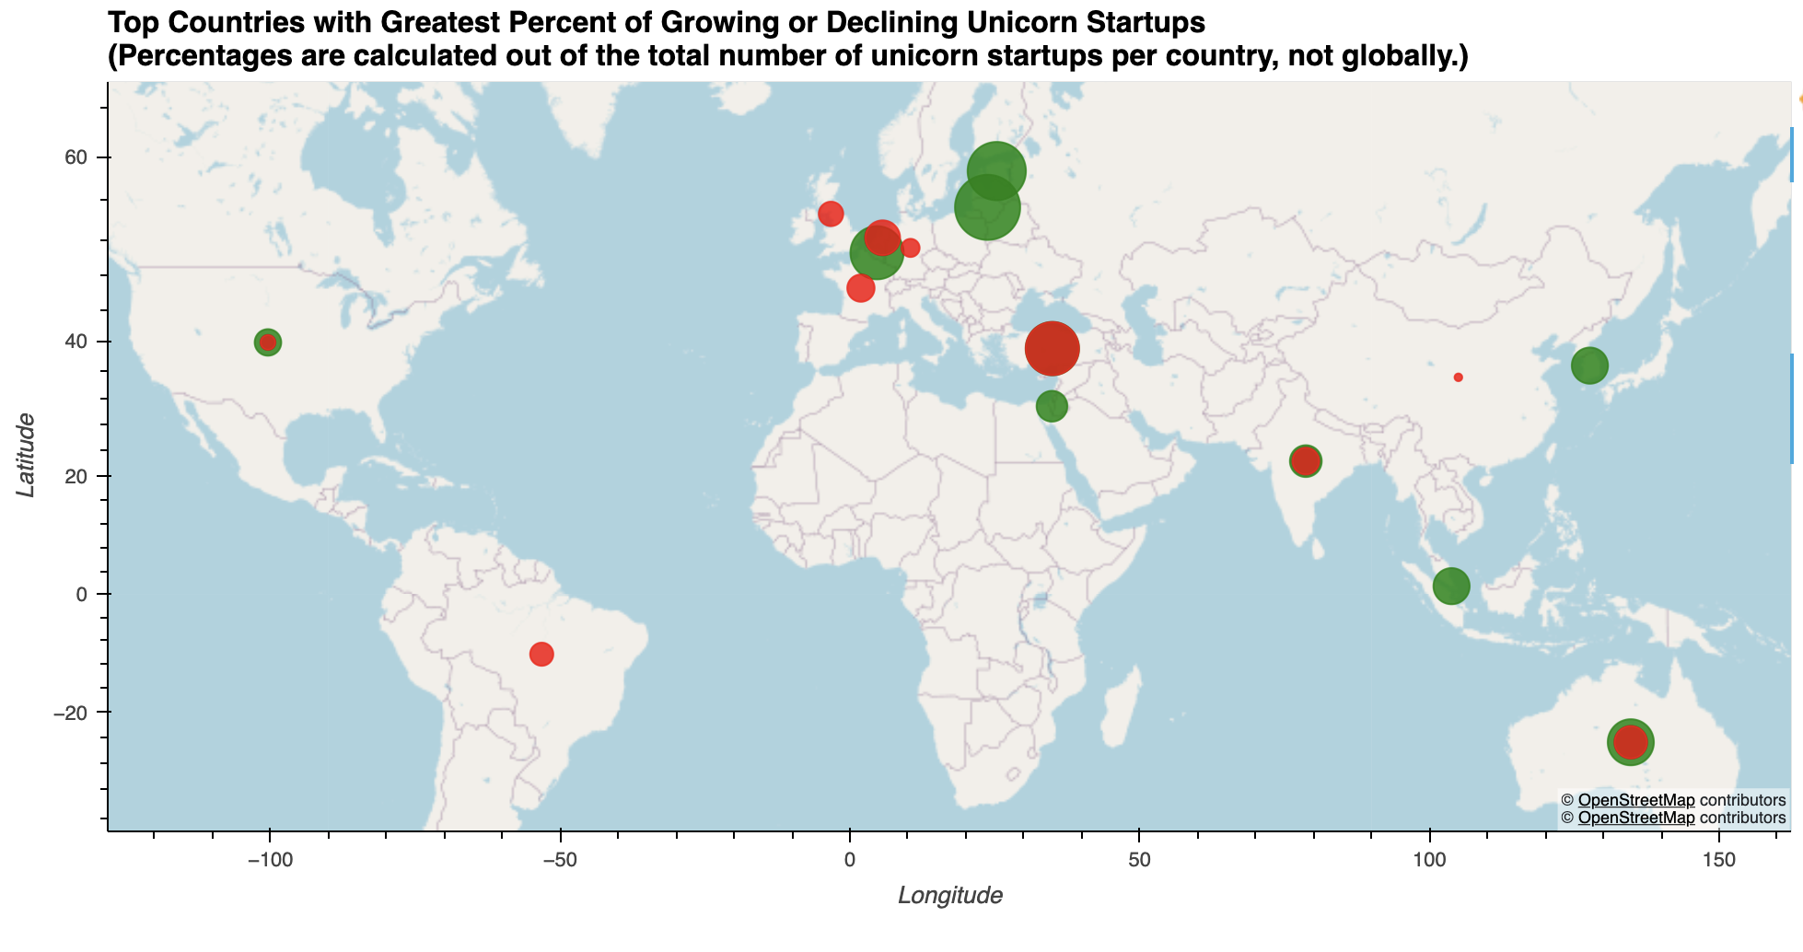
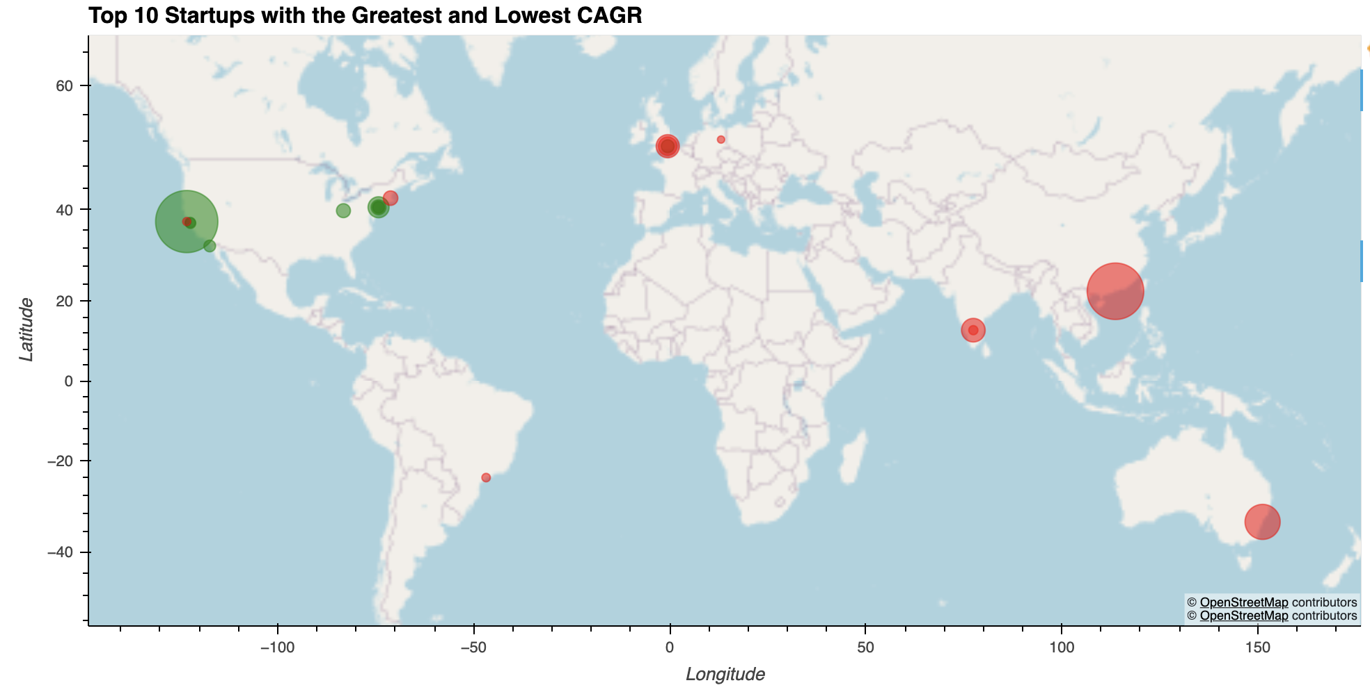

Slide 15
Data Set Sources:
CB Insights:
- https://www.cbinsights.com/research-unicorn-companies
Kaggle:
- https://www.kaggle.com/datasets/tahzeer/unicorn-startup-companies-july-2023
- https://www.kaggle.com/datasets/ramjasmaurya/unicorn-startups
sources

